Slide 1
Semi-supervised Learning and Relevance Search on Networked Data
Ming Ji
Department of Computer Science
University of Illinois at Urbana-Champaign
May 2013

Slide 2
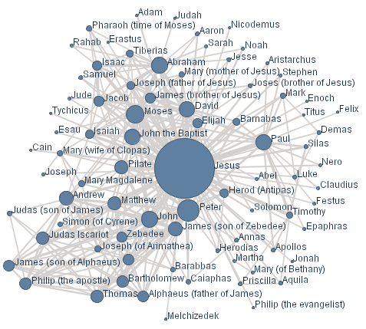


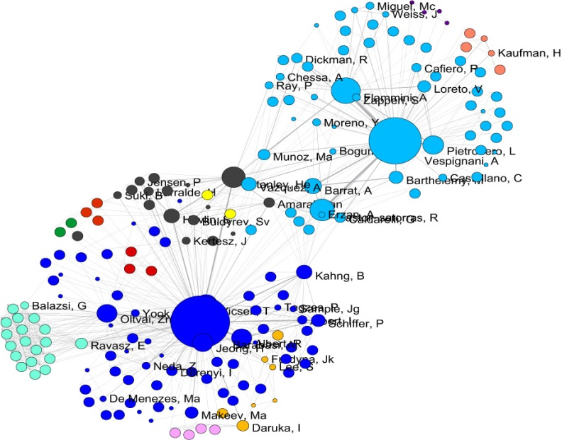
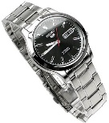





Booming age of networked data
Networks/graphs: data instances connected by edges representing meaningful relationships
Homogeneous
Heterogeneous
Social network
Co-author Network
E-commerce Network

Slide 3
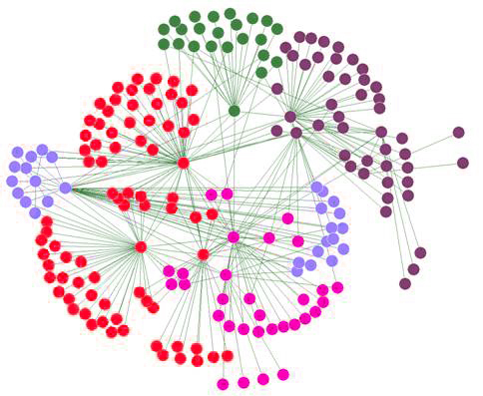
Semi-supervised learning (SSL) on networked data
Input: label information on some nodes
Output: labels on the unlabeled nodes
Both labeled and unlabeled data are utilized throughout the learning process
Labels + network structure
Wide applications
Community detection
Fraud detection
Product recommendation
And more…

Slide 4
Analyzing & improving existing SSL methods
Analyze
What is the generalization error or expected error of a given SSL method?
Improve
Active learning: select the most valuable examples to label
Feature selection: select the best set of features to represent the data
Integrating ranking and SSL: provide a summary for each class learned by SSL

Slide 5
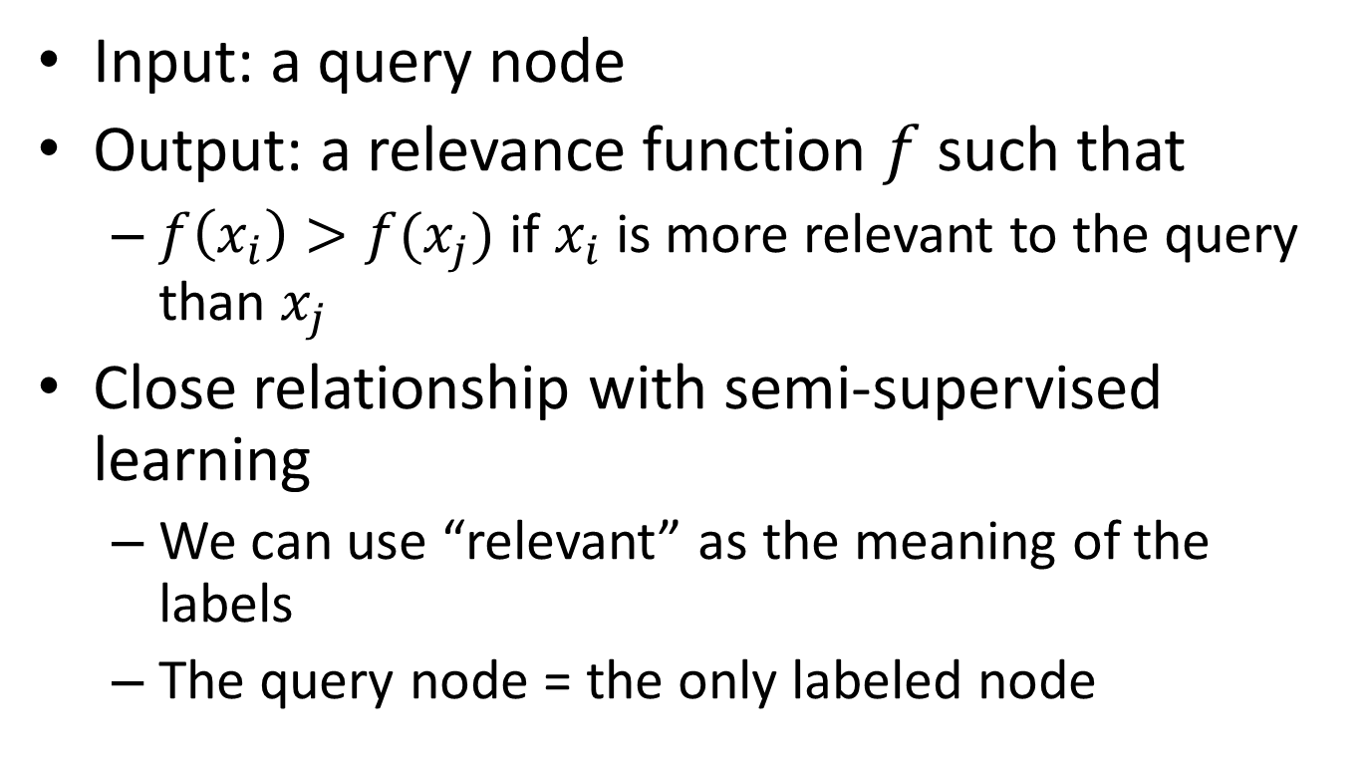
Relevance search on networked data
Input: a query node
Output: a relevance function $f$ such that
$f\left(x_{i}\right)>f(x_{j})$ if $x_{i}$ is more relevant to the query than $x_{j}$
Close relationship with semi-supervised learning
We can use “relevant” as the meaning of the labels
The query node = the only labeled node

Slide 6
Overview of my research
Problem
Analyze the error bound of SSL [ICML’12]
Analyzing & Improving Existing SSL Methods
Active learning to minimize the expected error of SSL [AISTATS’12]
Integrating ranking and SSL [KDD’11]
Minimize the expected error of LapRLS [CVPR’09, PAMI’11]
SSL (Semi-supervised Learning)
LapRLS [Belkin et al., 06], etc.
Label propagation [Zhou et al., 03], etc.
Graph-regularized classification [PKDD’10, SIGIR’11]
Personalized PageRank [Jeh et al., 03], etc. Parallel Field Ranking [KDD’12]
Learning the relevance between different types of data
Relevance Search
Distance Metrics (Euclidean, cosine, etc.)
Non-networked Data
Homogeneous Networks
Heterogeneous Networks
Data

Slide 7
Overview of my research
Problem
Analyze the error bound of SSL [ICML’12]
Analyzing & Improving Existing SSL Methods
Active learning to minimize the expected error of SSL [AISTATS’12]
Integrating ranking and SSL [KDD’11]
Minimize the expected error of LapRLS [CVPR’09, PAMI’11]
SSL (Semi-supervised Learning)
LapRLS [Belkin et al., 06], etc.
Label propagation [Zhou et al., 03], etc.
Graph-regularized classification [PKDD’10, SIGIR’11]
Personalized PageRank [Jeh et al., 03], etc. Parallel Field Ranking [KDD’12]
Learning the relevance between different types of data
Relevance Search
Distance Metrics (Euclidean, cosine, etc.)
Non-networked Data
Homogeneous Networks
Heterogeneous Networks
Data

Slide 8
Active learning for improving SSL
Active learner
SSL method
Minimize the error
Without labels, the error is unknown, so we turn to analyze the expected prediction error
Different active learners should be paired with different SSL methods, but can be constructed based on the same criterion
Expected error minimization

Slide 9
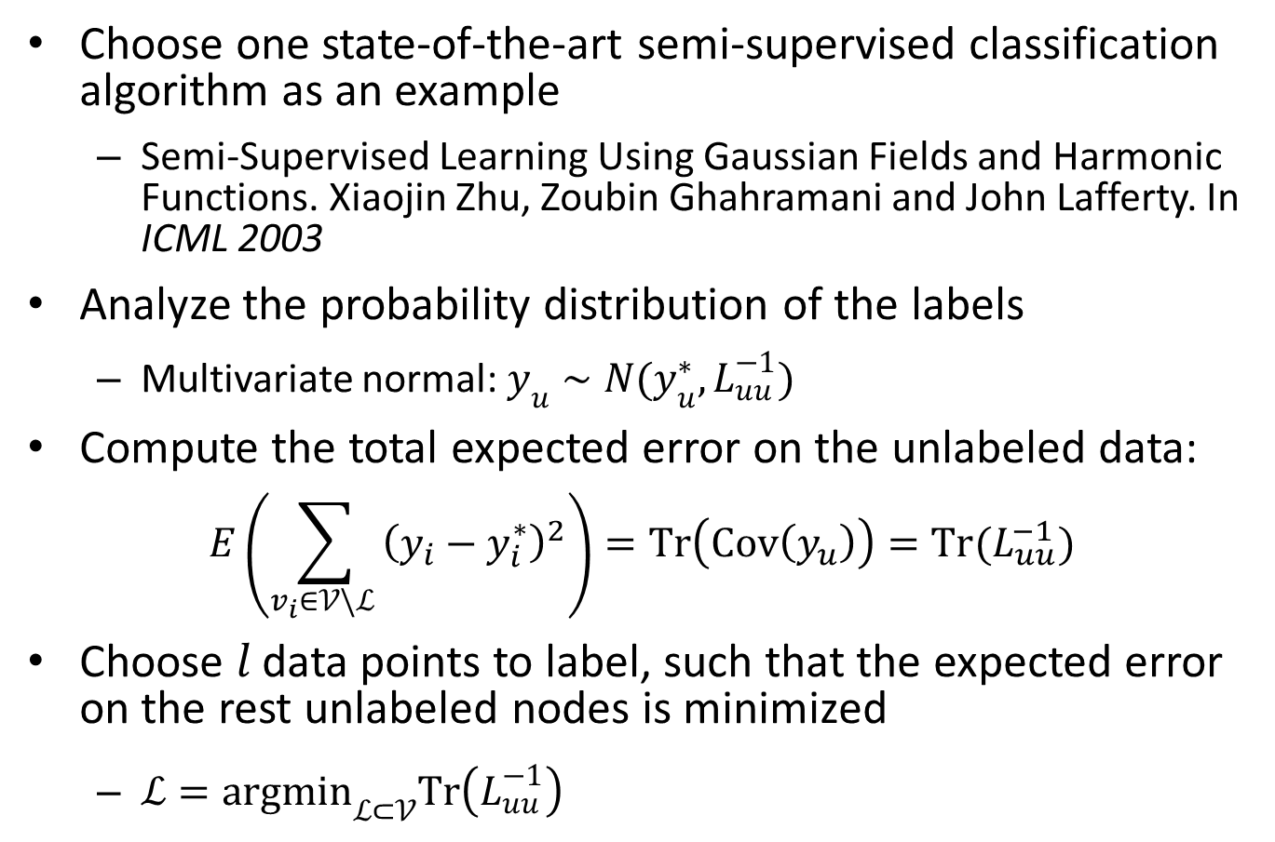
Methodology
Choose one state-of-the-art semi-supervised classification algorithm as an example
Semi-Supervised Learning Using Gaussian Fields and Harmonic Functions. Xiaojin Zhu, Zoubin Ghahramani and John Lafferty. In ICML 2003
Analyze the probability distribution of the labels
Multivariate normal: $y_{u}∼N(y_{u}^{∗}, L_{uu}^{−1})$
Compute the total expected error on the unlabeled data:
$$E\left(\sum_{v_{i}∈𝒱\backslash ℒ }{{\left(y_{i}−y_{i}^{∗}\right)}^{2}}\right)=Tr\left(Cov\left(y_{u}\right)\right)=Tr(L_{uu}^{−1})$$
Choose $l$ data points to label, such that the expected error on the rest unlabeled nodes is minimized
$ℒ={argmin}_{ℒ⊂𝒱}Tr\left(L_{uu}^{−1}\right)$

Slide 10
Highlights
The first work to theoretically minimize the expected prediction error of a semi-supervised classification method on networked data
The only information used: the network structure
Do not need any label information
The nodes do not need to have feature representation

Slide 11
Overview of my research
Problem
Analyze the error bound of SSL [ICML’12]
Analyzing & Improving Existing SSL Methods
Active learning to minimize the expected error of SSL [AISTATS’12]
Integrating ranking and SSL [KDD’11]
Minimize the expected error of LapRLS [CVPR’09, PAMI’11]
SSL (Semi-supervised Learning)
LapRLS [Belkin et al., 06], etc.
Label propagation [Zhou et al., 03], etc.
Graph-regularized classification [PKDD’10, SIGIR’11]
Personalized PageRank [Jeh et al., 03], etc. Parallel Field Ranking [KDD’12]
Learning the relevance between different types of data
Relevance Search
Distance Metrics (Euclidean, cosine, etc.)
Non-networked Data
Homogeneous Networks
Heterogeneous Networks
Data

Slide 12
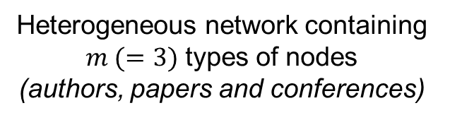
Definition of semi-supervised classification on heterogeneous networked data
Class 1
(data mining)
Class 2
(information retrieval)
Class 3
(machine learning)
Heterogeneous network containing $m (=3)$ types of nodes
(authors, papers and conferences)
Class: a group of multi-typed nodes sharing the same topic
Authors, papers and conferences in the same research area

Slide 13




The deficiency of doing semi-supervised classification only
Different nodes within one class have different importance/visibility!
The ranking of nodes within one class serves as an informative understanding and summary of the class
6
7
9
10
8
11
Notes:
An node within one class can either be very important (highly ranked), or unimportant (lowly ranked)
Classifying highly ranked nodes incorrectly is much more serious than making mistakes on lowly ranked nodes, and should cause more penalty.

Slide 14
The deficiency of doing ranking only
The class membership is critical to characterize each node!
Ranking nodes globally without considering the class information can often lead to dumb results
The dull ranking results in the mixed classes are not caused by the specific ranking scheme, but are due to the inherent incomparability between different classes.
Rank | Global Ranking | Within Database | Within Information Retrieval
1 | VLDB | VLDB | SIGIR
2 | SIGIR | SIGMOD | ECIR
3 | SIGMOD | ICDE | WWW
4 | ICDE | PODS | CIKM
5 | ECIR | EDBT | WSDM
Top-5 ranked conferences in different settings
Notes:
Ranking database and information retrieval conferences together may not make much sense since the top conferences in different classes are not really comparable.
The dull ranking results in the mixed classes are not caused by the specific ranking scheme,

Slide 15
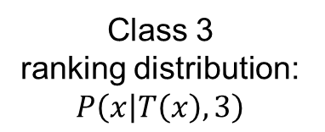
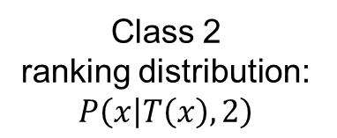
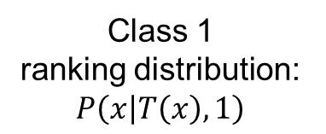
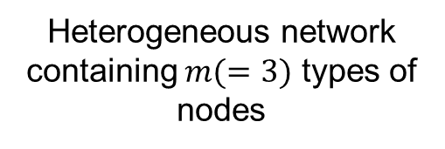
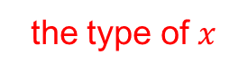
The novel definition of ranking-based classification
Class 1 ranking distribution: $P\left(x | T\left(x\right), 1\right)$
Class 2 ranking distribution: $P\left(x | T\left(x\right), 2\right)$
Class 3 ranking distribution: $P\left(x | T\left(x\right), 3\right)$
Heterogeneous network containing $m(=3)$ types of nodes
node
the type of $x$
class
Class: a group of multi-typed nodes sharing the same topic + within-class ranking

Slide 16
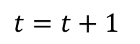
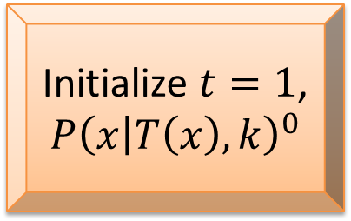
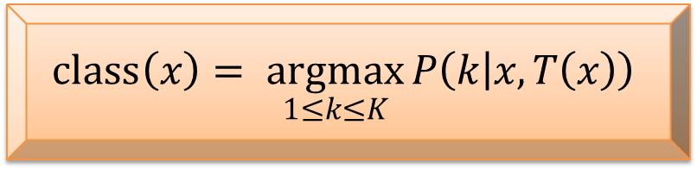
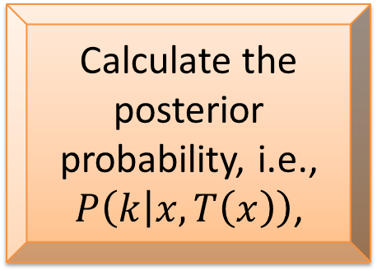
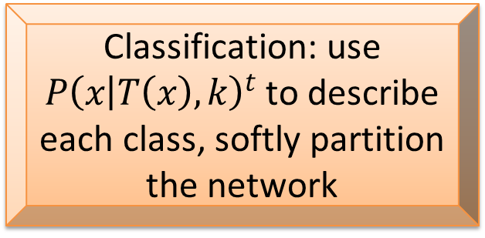
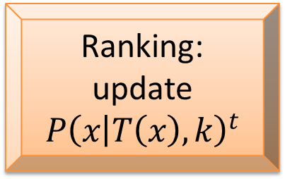
Framework of RankClass
Initialize $t=1$, $P{\left(x | T\left(x\right), k\right)}^{0}$
Ranking: update $P{\left(x | T\left(x\right), k\right)}^{t}$
$$t=t+1$$
Calculate the posterior probability, i.e., $P\left(k | x, T\left(x\right)\right)$,
Classification: use $P{\left(x | T\left(x\right), k\right)}^{t}$ to describe each class, softly partition the network
Converge
$$class\left(x\right)= \underset{1≤k≤K}{argmax}{P\left(k | x, T\left(x\right)\right)}$$
Notes:
why this method works?

Slide 17
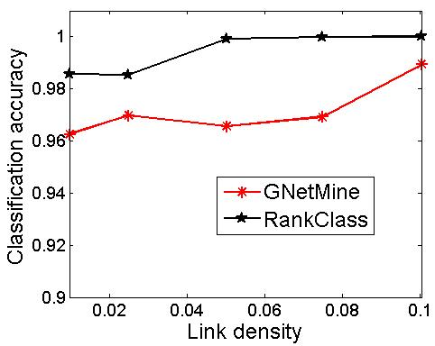
Experiments - Robustness tests
Data: LFR benchmark networks [Lancichinetti et al., 08]
The distribution of node degree follows the power law
2000 nodes, 2 classes, 1% nodes labeled
RankClass is robust when the network grows sparser

Slide 18
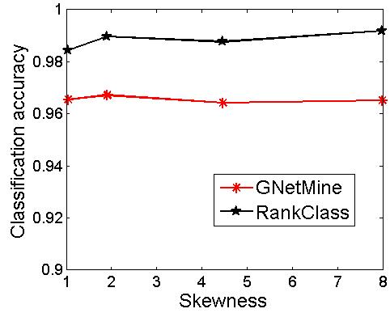
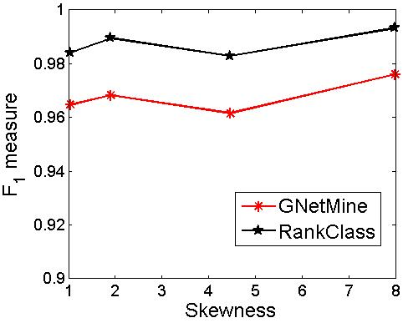
Experiments - Robustness tests
Data: LFR benchmark networks [Lancichinetti et al., 08]
Skewness = max(class size)/min(class size)
RankClass is robust when the class distribution is highly skewed
Overall performance
Performance on the smallest class

Slide 19
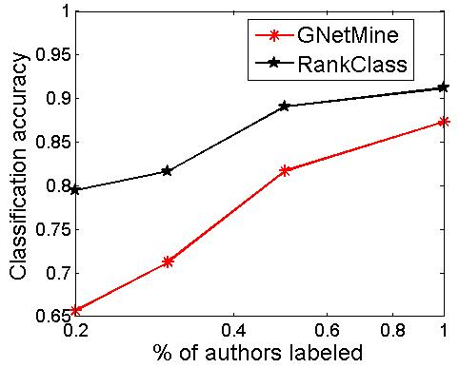
Experiments - Robustness tests
Data: randomly sample a sub-network with only 2000 authors from the DBLP network (originally has 14475 authors)
RankClass is robust when the data becomes sparse

Slide 20
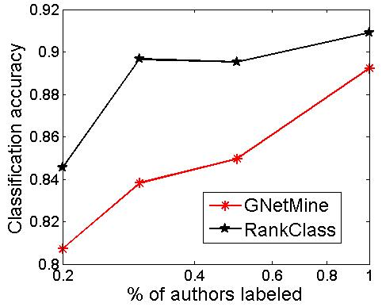
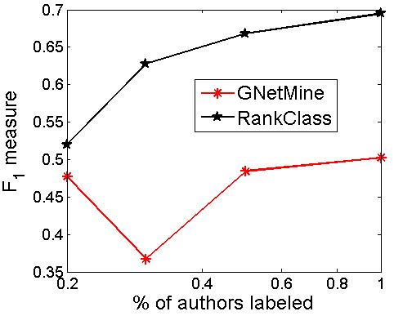
Experiments - Robustness tests
Data: randomly sample a sub-network from the DBLP network such that the percentage of authors belonging to data mining < 10%
RankClass is robust when the class distribution is highly skewed
Overall performance
Performance on the data mining class

Slide 21
Summary
Define and solve the problem of semi-supervised classification on heterogeneous networked data
Propose a novel definition of semi-supervised classification
Classes + within class ranking
A novel algorithm called RankClass is proposed to let ranking and classification mutually enhance each other
Generate more accurate and informative results
Notes:
identifying one class from a mixture of classes becomes more difficult since more noise is introduced by the increasing number of negative examples.
So it is beneficial to extract the sub-network of one class to study
this specific class.

Slide 22
Overview of my research
Problem
Analyze the error bound of SSL [ICML’12]
Analyzing & Improving Existing SSL Methods
Active learning to minimize the expected error of SSL [AISTATS’12]
Integrating ranking and SSL [KDD’11]
Minimize the expected error of LapRLS [CVPR’09, PAMI’11]
SSL (Semi-supervised Learning)
LapRLS [Belkin et al., 06], etc.
Label propagation [Zhou et al., 03], etc.
Graph-regularized classification [PKDD’10, SIGIR’11]
Personalized PageRank [Jeh et al., 03], etc. Parallel Field Ranking [KDD’12]
Learning the relevance between different types of data
Relevance Search
Distance Metrics (Euclidean, cosine, etc.)
Non-networked Data
Homogeneous Networks
Heterogeneous Networks
Data

Slide 23
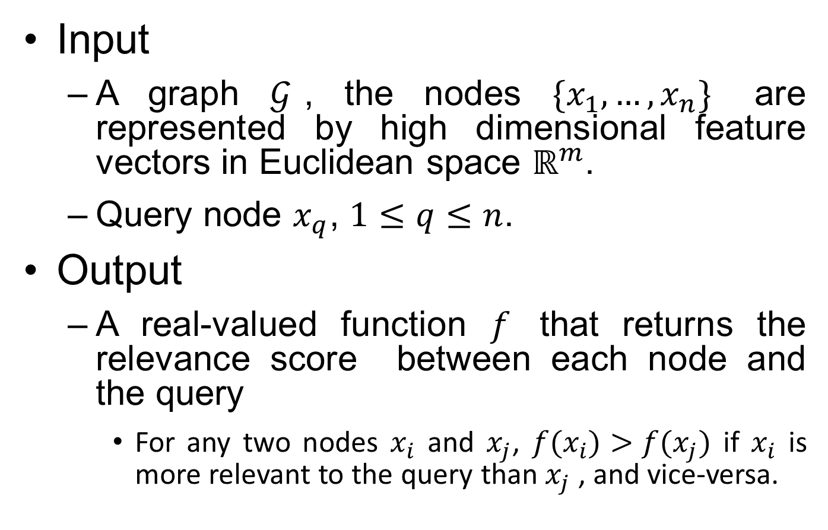
The relevance search problem
Input
A graph $𝒢$, the nodes $\{x_{1},…,x_{n}\}$ are represented by high dimensional feature vectors in Euclidean space $ℝ^{m}$.
Query node $x_{q}$, $1≤q≤n$.
Output
A real-valued function $f$ that returns the relevance score between each node and the query
For any two nodes $x_{i}$ and $x_{j}$, $f(x_{i})>f(x_{j})$ if $x_{i}$ is more relevant to the query than $x_{j}$ , and vice-versa.

Slide 24
Assumption and motivation
Assumption
The high dimensional data is sampled from a much lower dimensional submanifold embedded in the ambient Euclidean space
Neighboring nodes in the graph have similar feature vectors
Ideally, we want to learn a relevance function that:
has the highest value at the query point
varies linearly and therefore monotonically along the geodesics of the data manifold

Slide 25
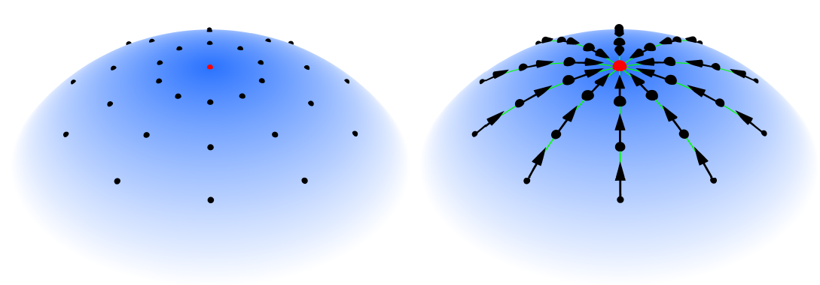
Objective
We want to learn a relevance function that:
has the highest value at the query point
varies linearly and therefore monotonically along the geodesics of the data manifold
(a) Data samples
(b) Ranking results

Slide 26

Highlights
Propose a novel relevance search algorithm on the data manifold from the vector field perspective.
Employ vector fields to ensure that the relevance function decreases linearly, and therefore monotonically from the query to other nodes along the geodesics of the manifold.
The ranking order along the geodesics is well preserved.
Notes:
identifying one class from a mixture of classes becomes more difficult since more noise is introduced by the increasing number of negative examples.
So it is beneficial to extract the sub-network of one class to study
this specific class.

Slide 27
Overview of my research
Problem
Analyze the error bound of SSL [ICML’12]
Analyzing & Improving Existing SSL Methods
Active learning to minimize the expected error of SSL [AISTATS’12]
Integrating ranking and SSL [KDD’11]
Minimize the expected error of LapRLS [CVPR’09, PAMI’11]
SSL (Semi-supervised Learning)
LapRLS [Belkin et al., 06], etc.
Label propagation [Zhou et al., 03], etc.
Graph-regularized classification [PKDD’10, SIGIR’11]
Personalized PageRank [Jeh et al., 03], etc. Parallel Field Ranking [KDD’12]
Learning the relevance between different types of data
Relevance Search
Distance Metrics (Euclidean, cosine, etc.)
Non-networked Data
Homogeneous Networks
Heterogeneous Networks
Data

Slide 28
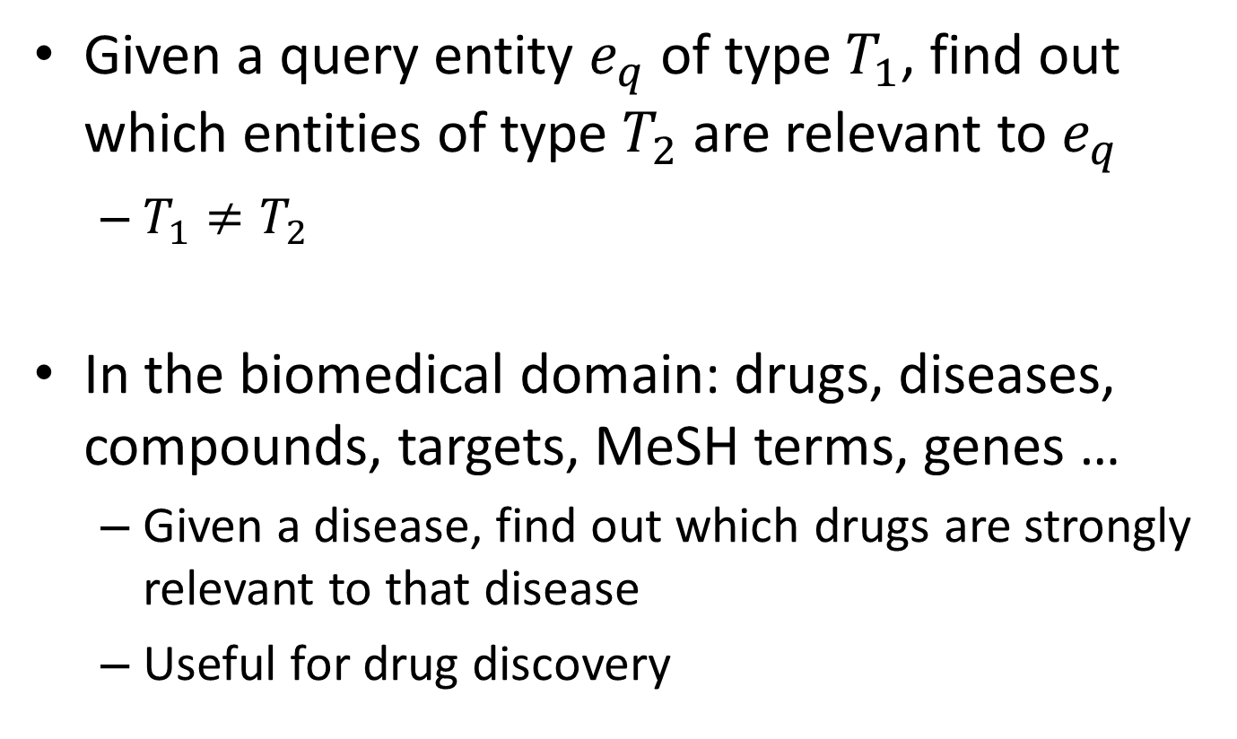
The problem
Given a query entity $e_{q}$ of type $T_{1}$, find out which entities of type $T_{2}$ are relevant to $e_{q}$
$T_{1}≠T_{2}$
In the biomedical domain: drugs, diseases, compounds, targets, MeSH terms, genes …
Given a disease, find out which drugs are strongly relevant to that disease
Useful for drug discovery

Slide 29

The motivation
If the data is structured, e.g., in a network/graph format
Y. Sun, J. Han, X. Yan, P. S. Yu, and T. Wu. Pathsim: Meta path-based top-k similarity search in heterogeneous information networks. PVLDB, 4(11):992–1003, 2011.
C. Shi, X. Kong, P. S. Yu, S. Xie, and B. Wu. Relevance search in heterogeneous networks. In EDBT, pages 180–191, 2012.
Unstructured text data are more ubiquitous
Biomedical papers and patents
Notes:
Can we build a heterogeneous network from the unstructured text data?

Slide 30
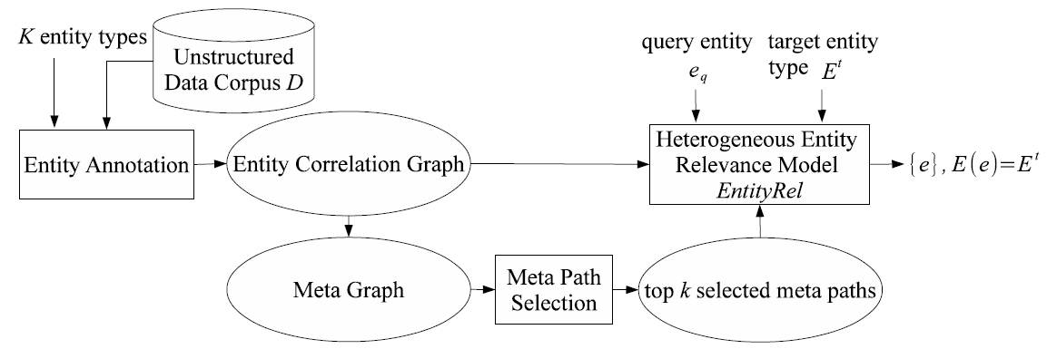
System framework

Slide 31
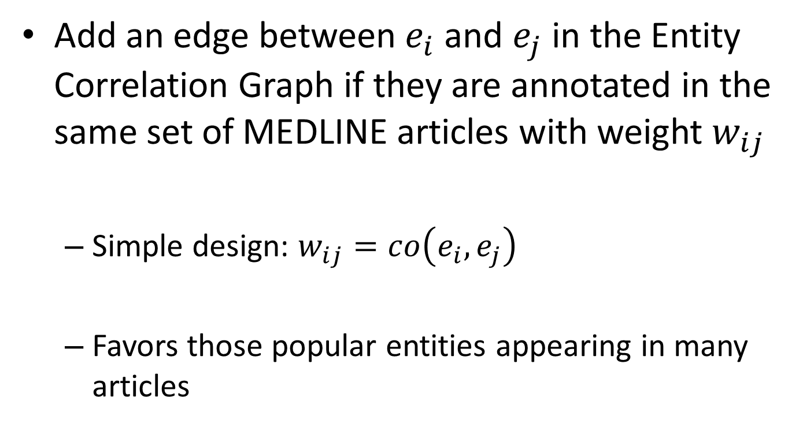
Correlation graph construction
Add an edge between $e_{i}$ and $e_{j}$ in the Entity Correlation Graph if they are annotated in the same set of MEDLINE articles with weight $w_{ij}$
Simple design: $w_{ij}=co\left(e_{i},e_{j}\right)$
Favors those popular entities appearing in many articles

Slide 32
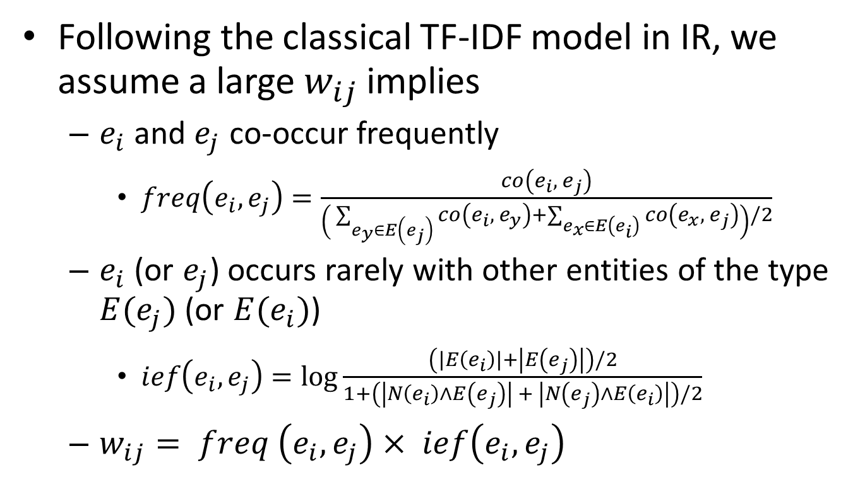
Correlation graph construction
Following the classical TF-IDF model in IR, we assume a large $w_{ij}$ implies
$e_{i}$ and $e_{j}$ co-occur frequently
$freq\left(e_{i}, e_{j}\right)=\frac{co\left(e_{i}, e_{j}\right)}{\left( \sum_{e_{y}∈E\left(e_{j}\right)}{co\left(e_{i}, e_{y}\right)}+\sum_{e_{x}∈E\left(e_{i}\right)}{co\left(e_{x}, e_{j}\right)}\right)/2}$
$e_{i}$ (or $e_{j}$) occurs rarely with other entities of the type $E(e_{j})$ (or $E(e_{i})$)
$ief\left(e_{i}, e_{j}\right)=\log{\frac{\left(\left|E\left(e_{i}\right)\right|+\left|E\left(e_{j}\right)\right|\right)/2}{1+\left(\left|N\left(e_{i}\right)∧E\left(e_{j}\right)\right| + \left|N\left(e_{j}\right)∧E\left(e_{i}\right)\right|\right)/2}}$
$w_{ij}= freq \left(e_{i}, e_{j}\right)× ief\left(e_{i}, e_{j}\right)$

Slide 33
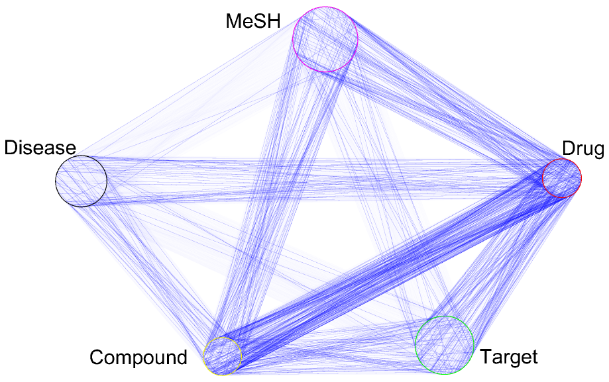
The entity correlation graph
The correlation between some types of entities (i.e., Drug -- Compound) is much stronger than others (i.e., MeSH – Disease)

Slide 34
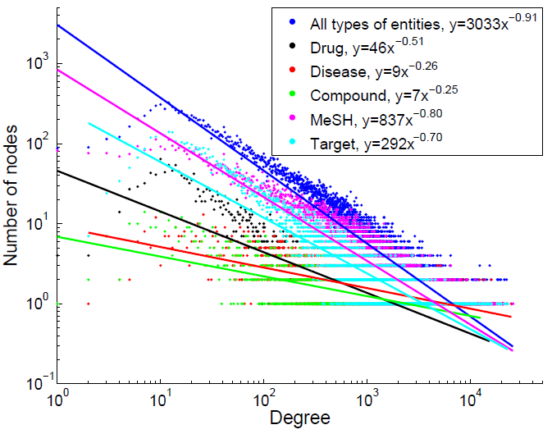
Degree distribution of the nodes

Slide 35
Small world phenomenon
91.75% of the nodes in the correlation graph belong to a giant connected component
The average distance between two nodes in this giant component is 2.0663
Starting from one node, we can quickly arrive at other nodes.
The graph offers rich contexts (numerous different paths) between two nodes

Slide 36
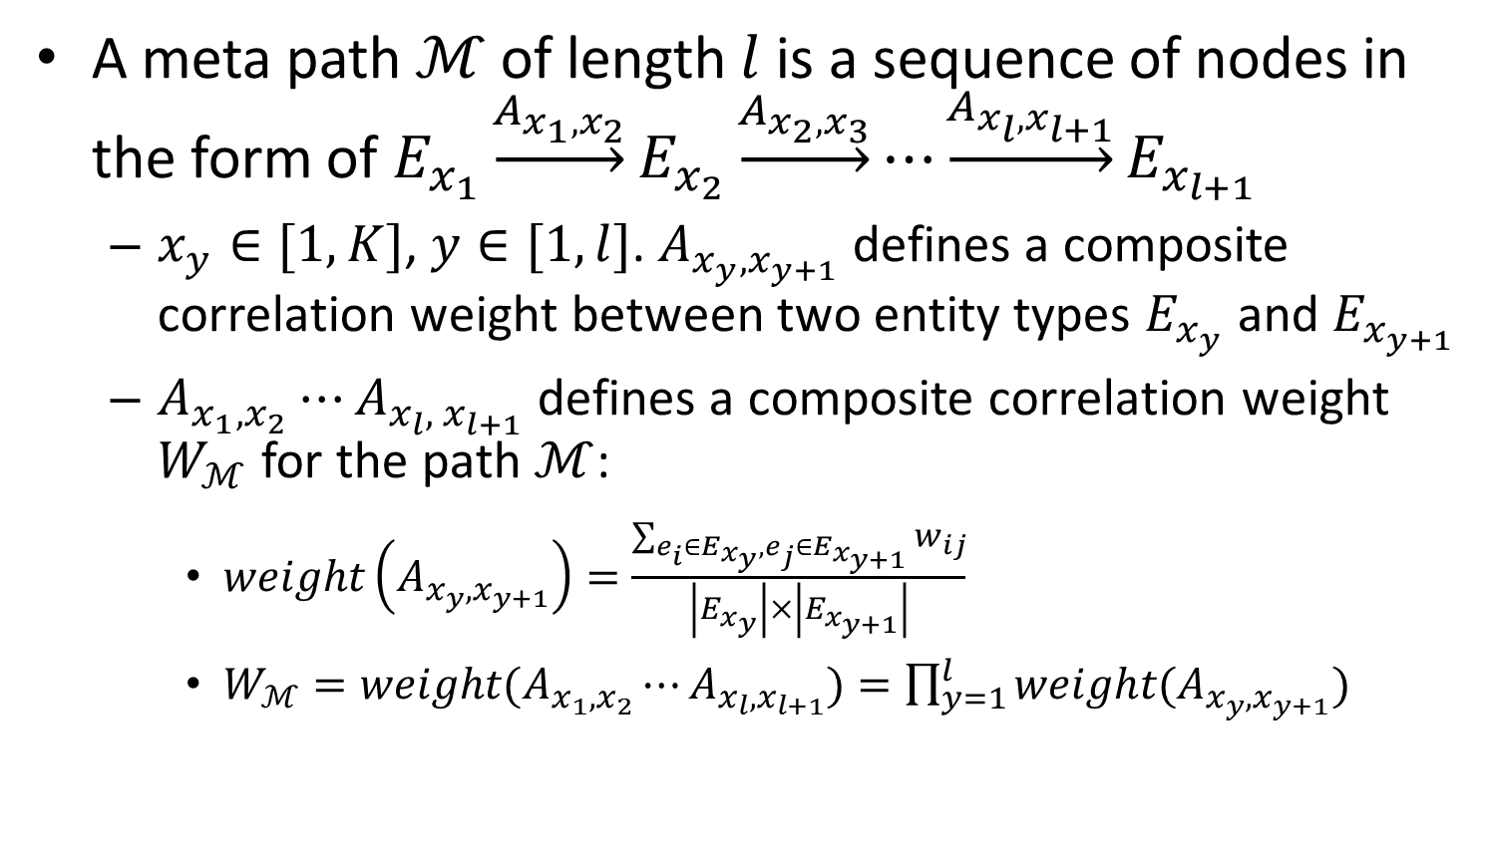
Meta path (path type)
A meta path $ℳ$ of length $l$ is a sequence of nodes in the form of $E_{x_{1}}\underset{→}{A_{x_{1},x_{2}}}E_{x_{2}}\underset{→}{A_{x_{2},x_{3}}}⋯\underset{→}{A_{x_{l},x_{l+1}}}E_{x_{l+1}}$
$x_{y}∈[1, K]$, $y∈[1, l]$. $A_{x_{y},x_{y+1}}$ defines a composite correlation weight between two entity types $E_{x_{y}}$ and $E_{x_{y+1}}$
$A_{x_{1},x_{2}}⋯A_{x_{l},{ x}_{l+1}}$ defines a composite correlation weight $W_{ℳ}$ for the path $ℳ$:
$weight\left(A_{x_{y}, x_{y+1}}\right)=\frac{\sum_{e_{i}∈E_{x_{y}}, e_{j}∈E_{x_{y+1}}}{w_{ij}}}{\left|E_{x_{y}}\right|×\left|E_{x_{y+1}}\right|}$
$W_{ℳ}=weight(A_{x_{1},x_{2}}⋯A_{x_{l}, x_{l+1}})=\prod_{y=1}^{l}{weight(A_{x_{y}, x_{y+1}})}$

Slide 37
What is a good meta path?
Not too long
Very long paths may cause concept drift and link two irrelevant entities together.
Path ``acne (Disease) -- skin (Target) -- muscle (Target) -- Ryanodine Receptor Calcium Release Channel (MeSH) -- rycals (Drug)" links the drug ``rycals" that treats skeletal muscle to an irrelevant disease ``acne".
Has many path instances
Imply strong relevance with high confidence in the data.

Slide 38
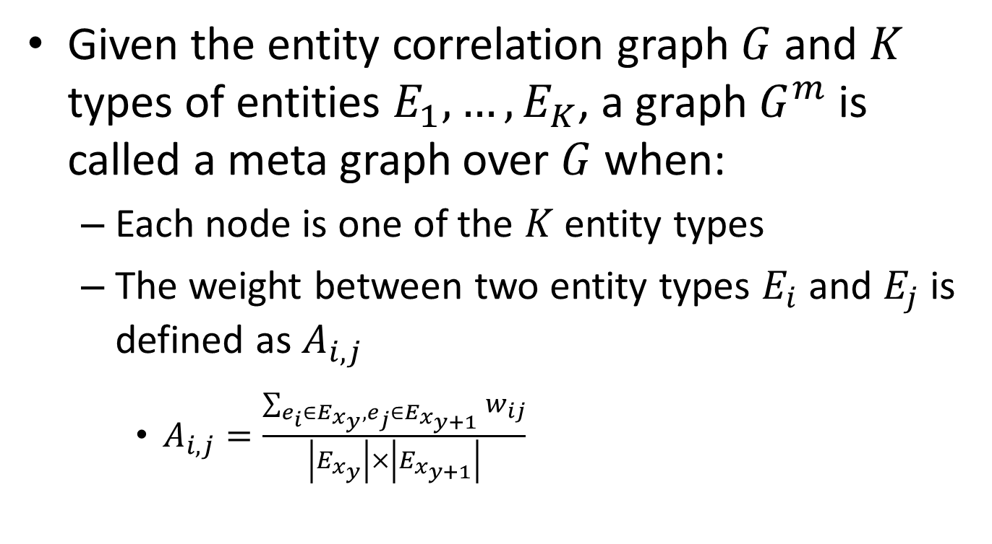
Meta graph
Given the entity correlation graph $G$ and $K$ types of entities $E_{1}, …, E_{K}$, a graph $G^{m}$ is called a meta graph over $G$ when:
Each node is one of the $K$ entity types
The weight between two entity types $E_{i}$ and $E_{j}$ is defined as $A_{i,j}$
$A_{i, j}=\frac{\sum_{e_{i}∈E_{x_{y}}, e_{j}∈E_{x_{y+1}}}{w_{ij}}}{\left|E_{x_{y}}\right|×\left|E_{x_{y+1}}\right|}$

Slide 39
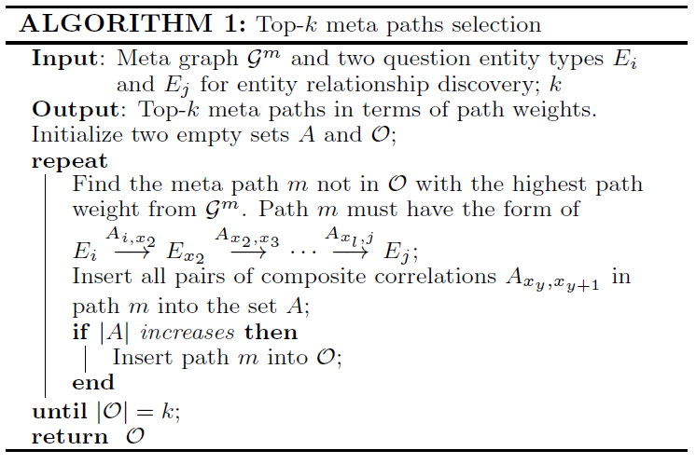
Greedy meta path selection algorithm

Slide 40
Results of meta path selection
Selecting two entity types Drug and Disease as an example, we select the following top meta paths:
Drug - Disease
Drug - Drug - Disease
Drug - Compound - Disease
Drug - Disease - Disease
Drug - MeSH - Disease

Slide 41
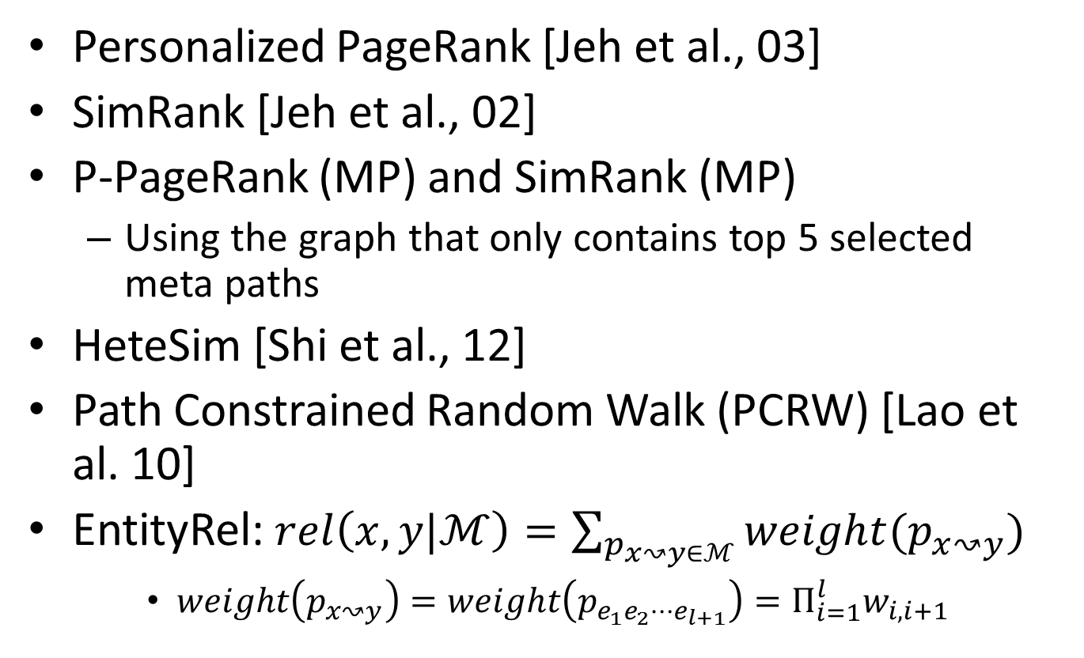
Relevance search over the constructed heterogeneous graph
Personalized PageRank [Jeh et al., 03]
SimRank [Jeh et al., 02]
P-PageRank (MP) and SimRank (MP)
Using the graph that only contains top 5 selected meta paths
HeteSim [Shi et al., 12]
Path Constrained Random Walk (PCRW) [Lao et al. 10]
EntityRel: $rel\left(x,y|ℳ\right)=\sum_{p_{x↝y∈ℳ}}{weight(p_{x↝y})}$
$weight\left(p_{x↝y}\right)=weight\left(p_{e_{1}e_{2}⋯e_{l+1}}\right)=Π_{i=1}^{l}w_{i, i+1}$

Slide 42
Experimental results
Data set
Entire Medline corpus (abstracts of 20,642,063 articles)
FDA drug dictionary: 5867 drugs
Disease dictionary: 4244 diseases
2254 compounds with the hierarchical biological roles in Chebi ontology, 18,587 MeSH terms, 18,014 targets
Ground truth
51 diseases treated by 201 drugs
Human labels
Notes:
brief

Slide 43
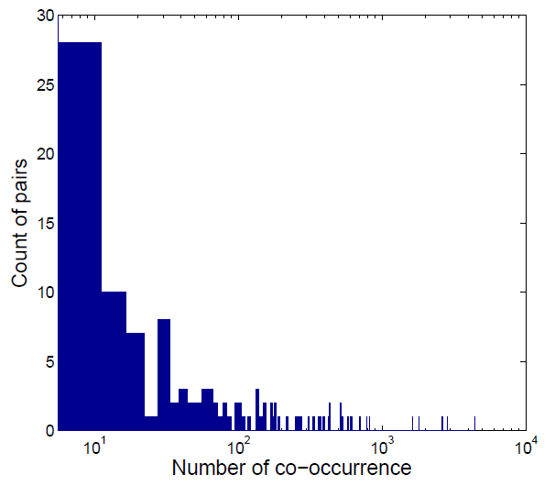
Co-occurrence distribution of the ground truth drug-disease pairs

Slide 44
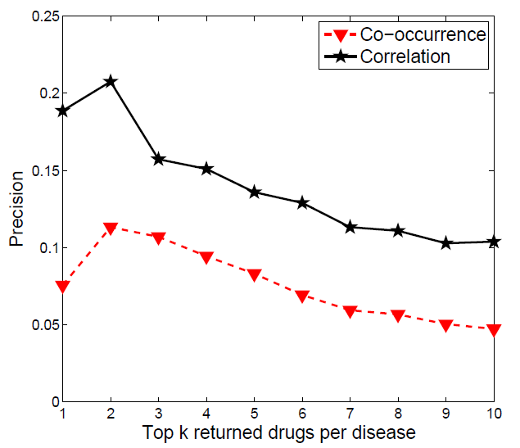
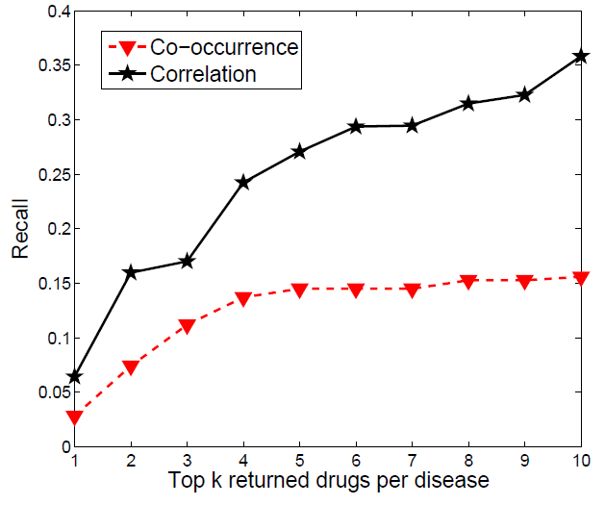
Correlation weight evaluation
Use the correlation weight function as a naive solution of the relevance function

Slide 45
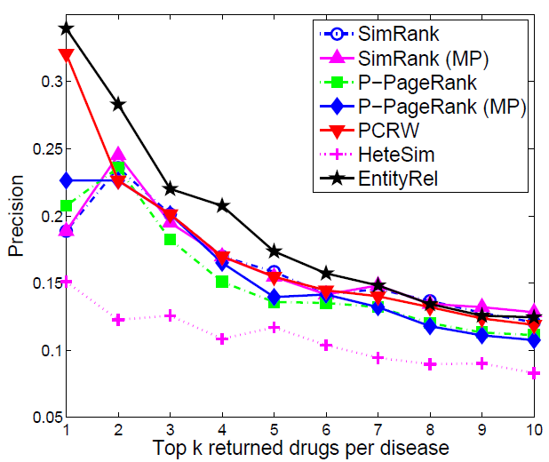
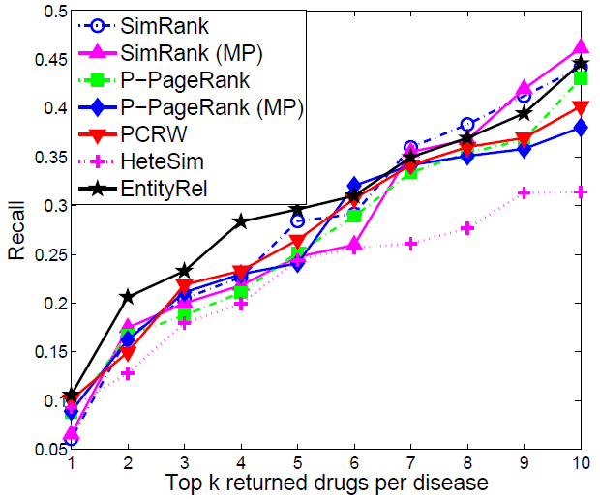
Comparing different methods on the same entity correlation graph

Slide 46
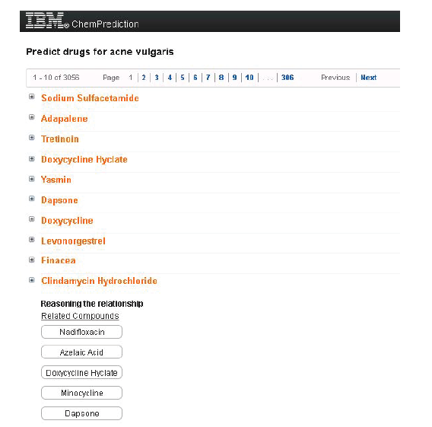
Heterogeneous entity search engine

Slide 47
Summary
Build a heterogeneous network from the unstructured text data
Extend the scope of my thesis
Study the problem of relevance search between different types of data from the meta path perspective
The proposed framework is generic and can be applied in other domains

Slide 48
Future work
Studying the relevance search problem on heterogeneous networks in a more principled way
Theoretically analyzing and improving the performance of existing SSL methods
On heterogeneous networks
Active learning: investigate interactive mode methods
Network construction
Mining noisy networks
Improving the scalability of proposed methods

Slide 49
My publications
[1] X. He, M. Ji, and H. Bao. Graph embedding with constraints. In IJCAI, pages 1065-1070, 2009.
[2] X. He, M. Ji, and H. Bao. A unified active and semi-supervised learning framework for image compression. In CVPR, pages 65–72, 2009.
[3] X. He, M. Ji, C. Zhang, and H. Bao. A variance minimization criterion to feature selection using laplacian regularization. IEEE Trans. Pattern Anal. Mach. Intell., 33(10):2013–2025, 2011.
[4] M. Ji and J. Han. A variance minimization criterion to active learning on graphs. Journal of Machine Learning Research-Proceedings Track, 22:556–564, 2012.
[5] M. Ji, J. Han, and M. Danilevsky. Ranking-based classification of heterogeneous information networks. In KDD, pages 1298–1306, 2011.
[6] M. Ji, B. Lin, X. He, D. Cai, and J. Han. Parallel field ranking. In KDD, pages 723–731, 2012.
[7] M. Ji, Y. Sun, M. Danilevsky, J. Han, and J. Gao. Graph regularized transductive classification on heterogeneous information networks. In ECML/PKDD (1), pages 570–586, 2010.
[8] M. Ji, J. Yan, S. Gu, J. Han, X. He, W. V. Zhang, and Z. Chen. Learning search tasks in queries and web pages via graph regularization. In SIGIR, pages 55–64, 2011.
[9] M. Ji, T. Yang, B. Lin, R. Jin, and J. Han. A simple algorithm for semi-supervised learning with improved generalization error bound. In ICML, pages 1223–1230, July 2012.
[10] Z. Li, J. Han, M. Ji, L. A. Tang, Y. Yu, B. Ding, J.-G. Lee, and R. Kays. Movemine: Mining moving object data for discovery of animal movement patterns. ACM TIST, 2(4):37, 2011.
[11] Z. Li, M. Ji, J.-G. Lee, L. A. Tang, Y. Yu, J. Han, and R. Kays. Movemine: mining moving object databases. In SIGMOD, pages 1203–1206, 2010.
[12] C. Wang, H. Wang, J. Liu, M. Ji, L. Su, Y. Chen, J. Han. On the Detectability of Node Grouping in Networks. In SDM, May 2013.
[13] M. Ji, B. Lin, X. He, D. Cai, and J. Han. Parallel field ranking. In TKDD, 2013.

Slide 50
Acknowledgements
Thanks to
Prof. Jiawei Han
Prof. Dan Roth
Prof. Thomas Huang
Prof. Yuguo Chen
Prof. Jieping Ye
All my collaborators
All members in the DAIS group

Slide 51
Thank you!
Questions?

Slide 52
Backup slides

Slide 53

Active learning: the problem
Ground truth
Labels
Predictor
Different labeled data will train different predictors
Which nodes should we label in order to get a good predictor?

Slide 54
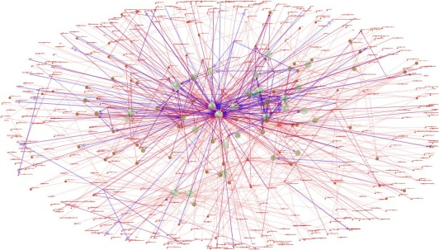

Active learning: the problem
Input:
Output: find out which nodes should be labeled
Goal: optimize the performance of the predictor learned under a fixed budget of labeling effort
SSL method

Slide 55
Existing work
Different selection heuristics
Certain [Kuwadekar et al., 10] vs. uncertain [Shi et al., 10]?
Certain data: already have good prediction, maybe don’t need to label?
Uncertain: could be noise or outlier?
Cluster center [Kuwadekar et al., 10] vs. boundary?
Major limitation: none of them can theoretically guarantee that the predictor trained by the labeled nodes has the best performance (= minimum error)
budget = 3
budget = 5

Slide 56
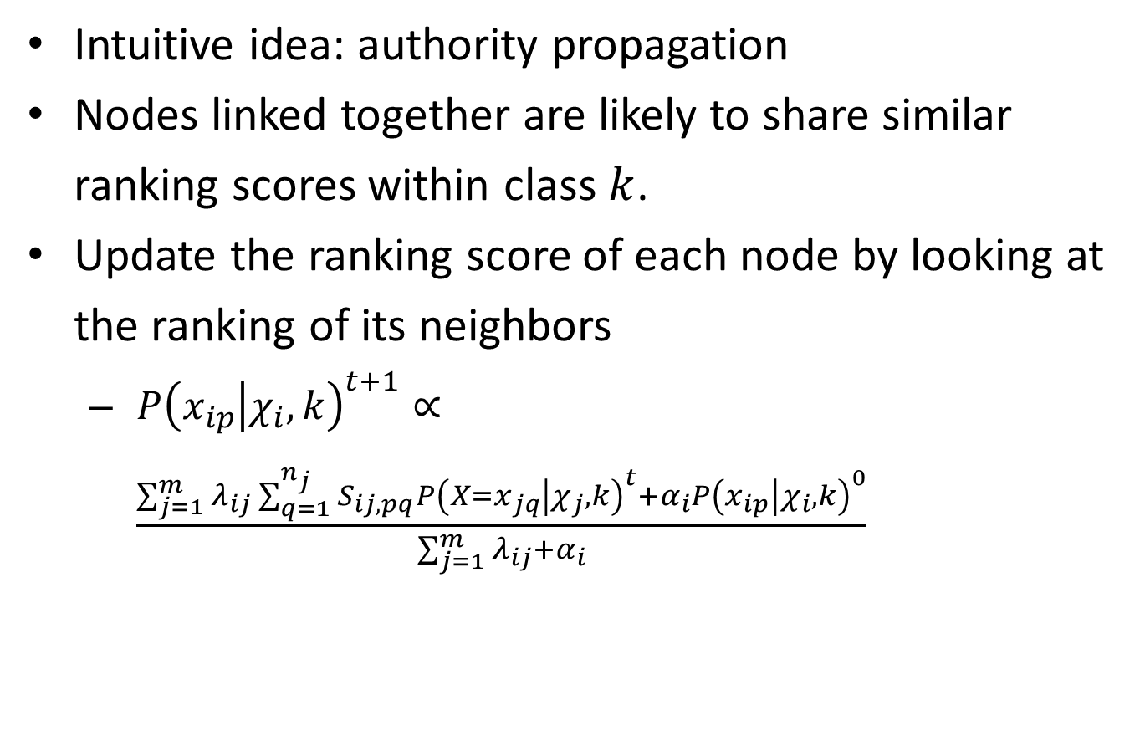
Graph-based ranking
Intuitive idea: authority propagation
Nodes linked together are likely to share similar ranking scores within class $k$.
Update the ranking score of each node by looking at the ranking of its neighbors
$P{\left(x_{ip} | χ_{i}, k\right)}^{t+1}∝\frac{\sum_{j=1}^{m}{λ_{ij}\sum_{q=1}^{n_{j}}{S_{ij, pq}P{\left(X=x_{jq} | χ_{j}, k\right)}^{t}}}+α_{i}P{\left(x_{ip} | χ_{i}, k\right)}^{0}}{\sum_{j=1}^{m}{λ_{ij}}+α_{i}}$
The initial ranking score
Weighted average of the neighbors’ ranking scores
Notes:
Note that we use the normalized relation matrices instead of the original ones: $$S_{ij}=D_{ij}^{(−\frac{1}{2})}R_{ij}D_{ji}^{(−\frac{1}{2})}, D_{ij}=diag\left[\sum_{q}{R_{ij, pq}}\right]$$ This not only generates more stable results, but also supports the later steps since multiplying $R_{ij}$ by any constant will not change $S_{ij}$

Slide 57
Partition the network softly
Ideally, the within-class ranking should be performed within the sub-network corresponding to each class
Use the ranking distribution to describe each class
Gradually emphasize the network on highly ranked nodes, and weaken the network on lowly ranked nodes
Sub-network for class 1
Sub-network for class 2
Sub-network for class 3
Original network

Slide 58
Experiments
Dataset: DBLP
4 research areas (classes)
Database, data mining, information retrieval, artificial intelligence
4 types of nodes
Paper (14376), Conference (20), Author (14475), Term (8920)
3 types of relations
Paper-conference, paper-author, paper-term
Conference
Author
Paper
Term

Slide 59
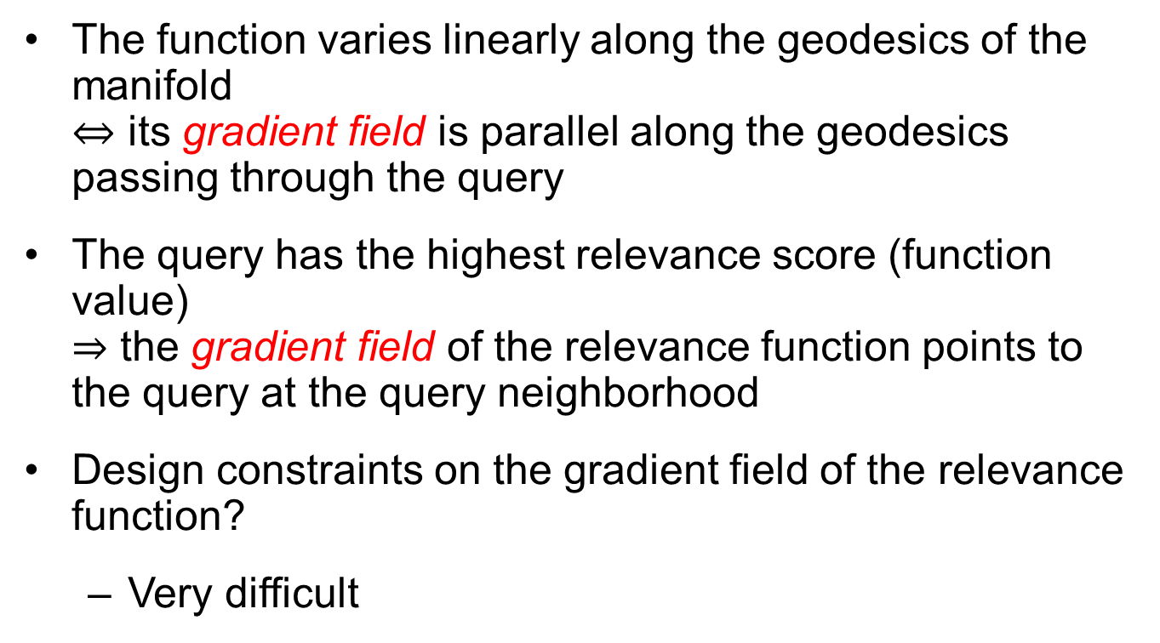
Encoding the motivation
The function varies linearly along the geodesics of the manifold $⇔$ its gradient field is parallel along the geodesics passing through the query
The query has the highest relevance score (function value) $⇒$ the gradient field of the relevance function points to the query at the query neighborhood
Design constraints on the gradient field of the relevance function?
Very difficult

Slide 60
Methodology overview
Learn a vector field to approximate the gradient field of the relevance function
Design constraints on the vector field based on three intuitions
The vector field should be close to the gradient field of the relevance function.
The vector field should be as parallel as possible.
The vector field at the neighborhood around the query should point to the query.
Ensure the linearity
Ensure the query point has the highest relevance score

Slide 61
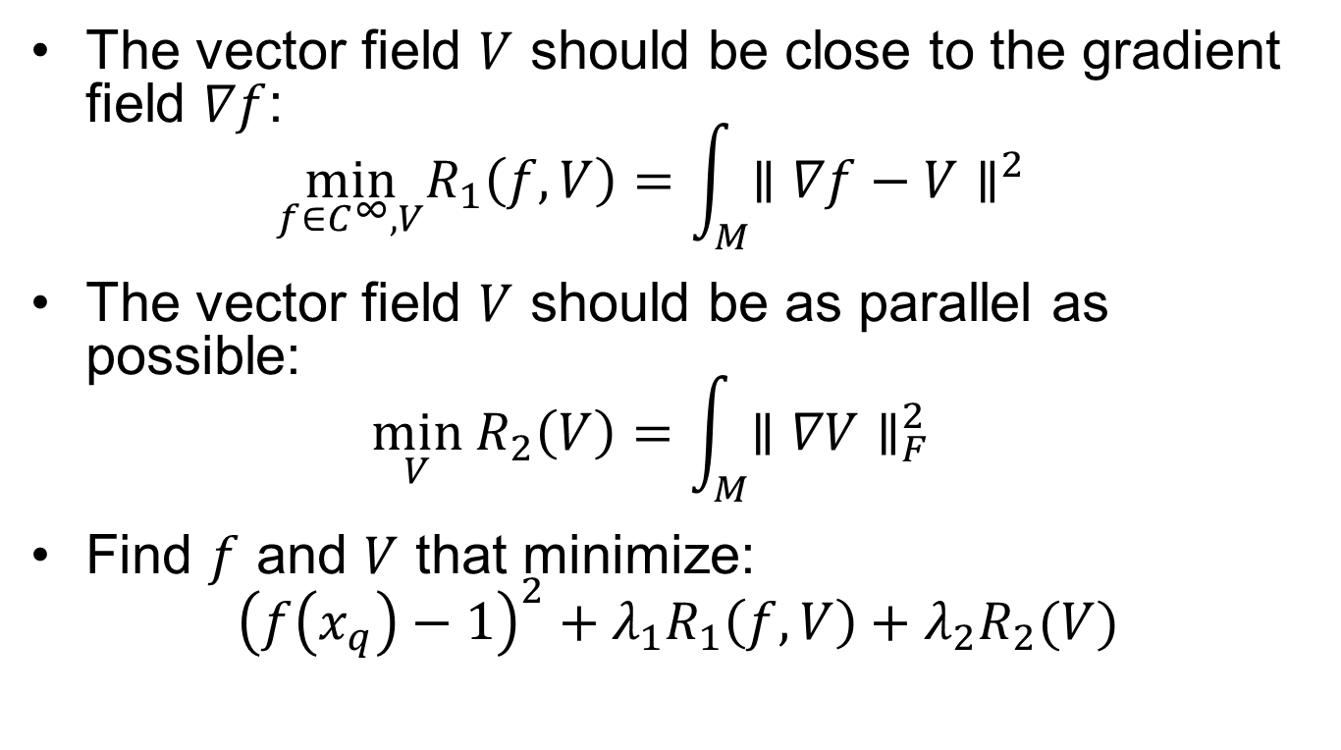
Ensuring the linearity
The vector field $V$ should be close to the gradient field $∇f$: $\min_{f∈C^{∞},V}R_{1}\left(f,V\right)=\int_{M}{∥∇f−V∥^{2}}$
The vector field $V$ should be as parallel as possible: $\min_{V}{ R}_{2}\left(V\right)=\int_{M}{∥∇V∥_{F}^{2}}$
Find $f$ and $V$ that minimize: ${\left(f\left(x_{q}\right)−1\right)}^{2}+λ_{1}R_{1}\left(f,V\right)+λ_{2}R_{2}(V)$

Slide 62
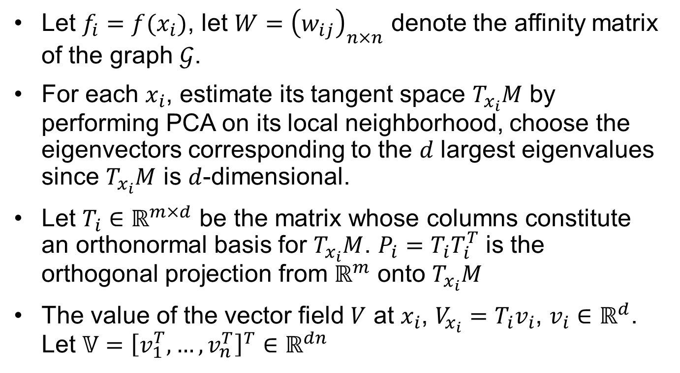
Discretization
Let $f_{i}=f(x_{i})$, let $W={\left(w_{ij}\right)}_{n×n}$ denote the affinity matrix of the graph $𝒢$.
For each $x_{i}$, estimate its tangent space $T_{x_{i}}M$ by performing PCA on its local neighborhood, choose the eigenvectors corresponding to the $d$ largest eigenvalues since $T_{x_{i}}M$ is $d$-dimensional.
Let $T_{i}∈ℝ^{m×d}$ be the matrix whose columns constitute an orthonormal basis for $T_{x_{i}}M$. $P_{i}=T_{i}T_{i}^{T}$ is the orthogonal projection from $ℝ^{m}$ onto $T_{x_{i}}M$
The value of the vector field $V$ at $x_{i}$, $V_{x_{i}}=T_{i}v_{i}$, $v_{i}∈ℝ^{d}$. Let $𝕍={\left[v_{1}^{T}, …, v_{n}^{T}\right]}^{T}∈ℝ^{dn}$

Slide 63
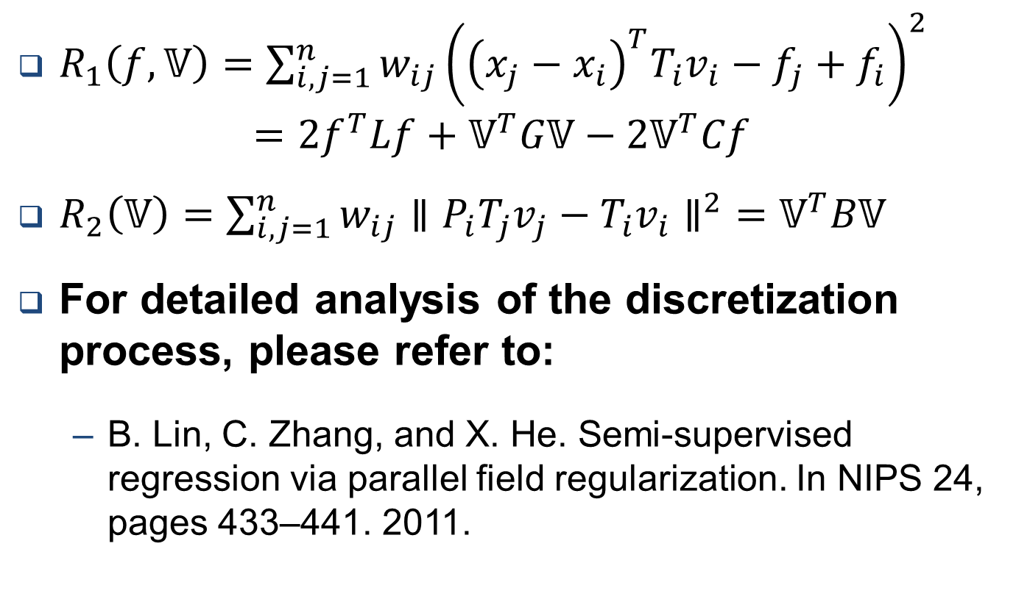
Discretization
$R_{1}\left(f,𝕍\right)=\sum_{i, j=1}^{n}{w_{ij}{\left({\left(x_{j}−x_{i}\right)}^{T}T_{i}v_{i}−f_{j}+f_{i}\right)}^{2}}$ $=2f^{T}Lf+𝕍^{T}G𝕍−2𝕍^{T}Cf$
$R_{2}\left(𝕍\right)=\sum_{i, j=1}^{n}{w_{ij}∥P_{i}T_{j}v_{j}−T_{i}v_{i}∥^{2}}=𝕍^{T}B𝕍$
For detailed analysis of the discretization process, please refer to:
B. Lin, C. Zhang, and X. He. Semi-supervised regression via parallel field regularization. In NIPS 24, pages 433–441. 2011.

Slide 64
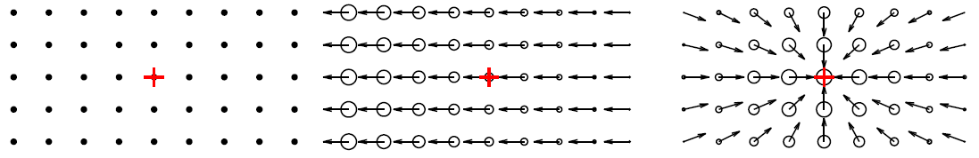
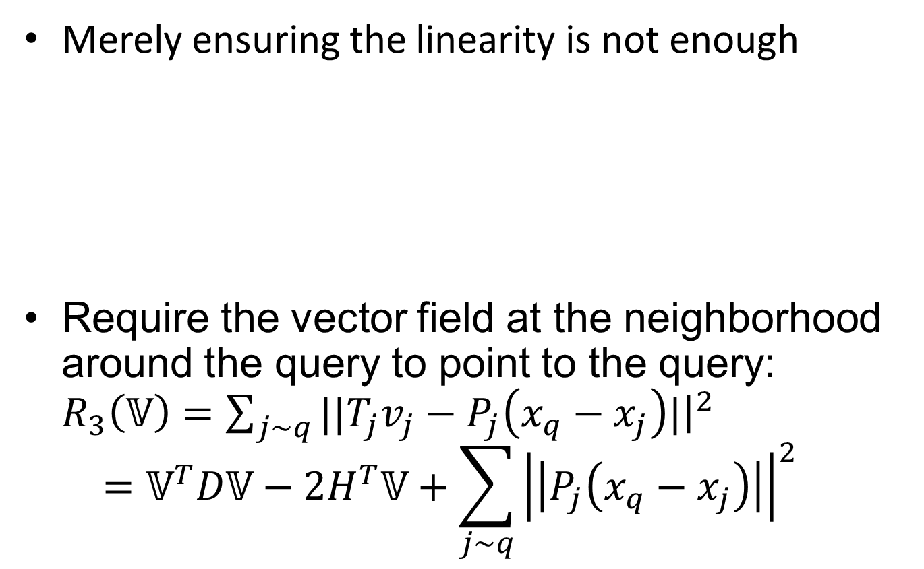


Encoding the third intuition
Merely ensuring the linearity is not enough
Require the vector field at the neighborhood around the query to point to the query: $R_{3}\left(𝕍\right)=\sum_{j∼q}{||T_{j}v_{j}−P_{j}\left(x_{q}−x_{j}\right)|{\left.​\right|}^{2}}$ $=𝕍^{T}D𝕍−2H^{T}𝕍+\sum_{j∼q}{{\left|\left|P_{j}\left(x_{q}−x_{j}\right)\right|\right|}^{2}}$
(a) Data samples
(b) Ranking without $R_{3}$
(c) Ranking with $R_{3}$

Slide 65

Final objective function
Find out $f$ and $𝕍$ that minimize: $J\left(f, 𝕍\right)={\left(f_{q}−1\right)}^{2}+λ_{1}R_{1}\left(f,𝕍\right)+λ_{2}R_{2}\left(𝕍\right)+λ_{3}R_{3}(𝕍)+λ_{3}R_{3}(𝕍)$
Optimization
Require $\frac{∂J(f, 𝕍)}{∂f}=0$ and $\frac{∂J(f, 𝕍)}{∂𝕍}=0$
Solve the linear system: $\left(\begin{matrix}𝕀+2λ_{1}L & −λ_{1}C^{T} \\ −λ_{1}C & λ_{1}G+λ_{2}B+λ_{3}D\end{matrix}\right)\left(\begin{matrix}f \\ 𝕍\end{matrix}\right)=\left(\begin{matrix}y \\ λ_{3}H\end{matrix}\right)$

Slide 66
Experiments
Algorithms for comparison
Our proposed Parallel Field Ranking (PFRank) algorithm
Laplacian-based manifold ranking algorithm (MR)
Ensures the smoothness of the relevance function.
But the actual variation of the relevance function along the geodesics of the manifold (monotonically or not) is unknown.
D. Zhou, J. Weston, A. Gretton, O. Bousquet, and B. Sch¨olkopf. Ranking on data manifolds. In NIPS 16, 2003.
Support Vector Machines (SVM)
Does not consider the manifold structure

Slide 67
Image search
Given an image as a query, we hope to rank all the images in the database according to their relevance to the query.
Data set
5,000 images of 50 semantic categories from the COREL database
Each image is represented by a 297-dimensional feature vector
1428 face images of 68 people from the CMU PIE face database
Each image is represented by a 1024-dimensional feature vector
Graph: build a nearest neighbor graph based on the features (following [Guillory et al., 09])

Slide 68

Image search
The average precision-scope curves of different relevance search algorithms

Slide 69
Image search
Performance comparison using different evaluation metrics
 | NDCG@10 | NDCG @20 | Recall@10 | Recall@20 | Recall@50 | Recall@100 | MAP
SVM | 0.297 | 0.279 | 0.066 | 0.121 | 0.242 | 0.404 | 0.244
MR | 0.312 | 0.302 | 0.061 | 0.116 | 0.237 | 0.371 | 0.237
PFRank | 0.435 | 0.388 | 0.091 | 0.152 | 0.272 | 0.394 | 0.256
The COREL data set
 | NDCG@10 | NDCG @20 | Recall@10 | Recall@20 | Recall@50 | Recall@100 | MAP
SVM | 0.761 | 0.530 | 0.503 | 0.570 | 0.631 | 0.695 | 0.575
MR | 0.537 | 0.446 | 0.383 | 0.583 | 0.698 | 0.806 | 0.441
PFRank | 0.786 | 0.605 | 0.572 | 0.750 | 0.847 | 0.889 | 0.729
The CMU PIE data set

Slide 70

Motivation
Let $f(e_{i}, e_{j})$ denote the relevance score between $e_{i}$ and $e_{j}$
The computation of $f(e_{i}, e_{j})$ depends on the observed correlations of $e_{i}$ and $e_{j}$ in the text data
Simplest way: $f(e_{i},e_{j})=co\left(e_{i},e_{j}\right)$
Cannot effectively capture the correlation contexts of $e_{i}$ and $e_{j}$.
Frequent sentence: Which is able to treat acne, doxycycline or tetracycline?
Is the drug entity “tetracycline” relevant to the disease entity “acne” or not?

Slide 71
Motivation
The correlation contexts between two entities can be manifested by other entities that frequently co-occur with both
Frequent sentence: Acne is a disease that affects the skin’s oil glands. => To treat the disease “acne”, the organism entity “skin” is one kind of targets.
Frequent sentence: Tetracyclines are oral antibiotics often used to treat skin diseases => The function scope of drug “tetracycline” covers the target entity “skin”.
The target entity “skin” effectively links the drug entity “tetracycline” and the disease entity “acne” together and implies their relevance!

Slide 72
Motivation
Use an undirected Entity Correlation Graph to encode the context information in the text
“Acne is a disease that affects the skin’s oil glands.” “Tetracyclines are oral antibiotics often used to treat skin diseases” => path: “tetracycline – skin – acne”
All the paths between “tetracycline” and “acne” collectively serve as the correlation contexts for the relevance between the two entities!

Slide 73


Comparing different meta paths

